Slide 1
Earth Science Concepts

Slide 2
Geology: the physical basis for environmental science

Slide 3
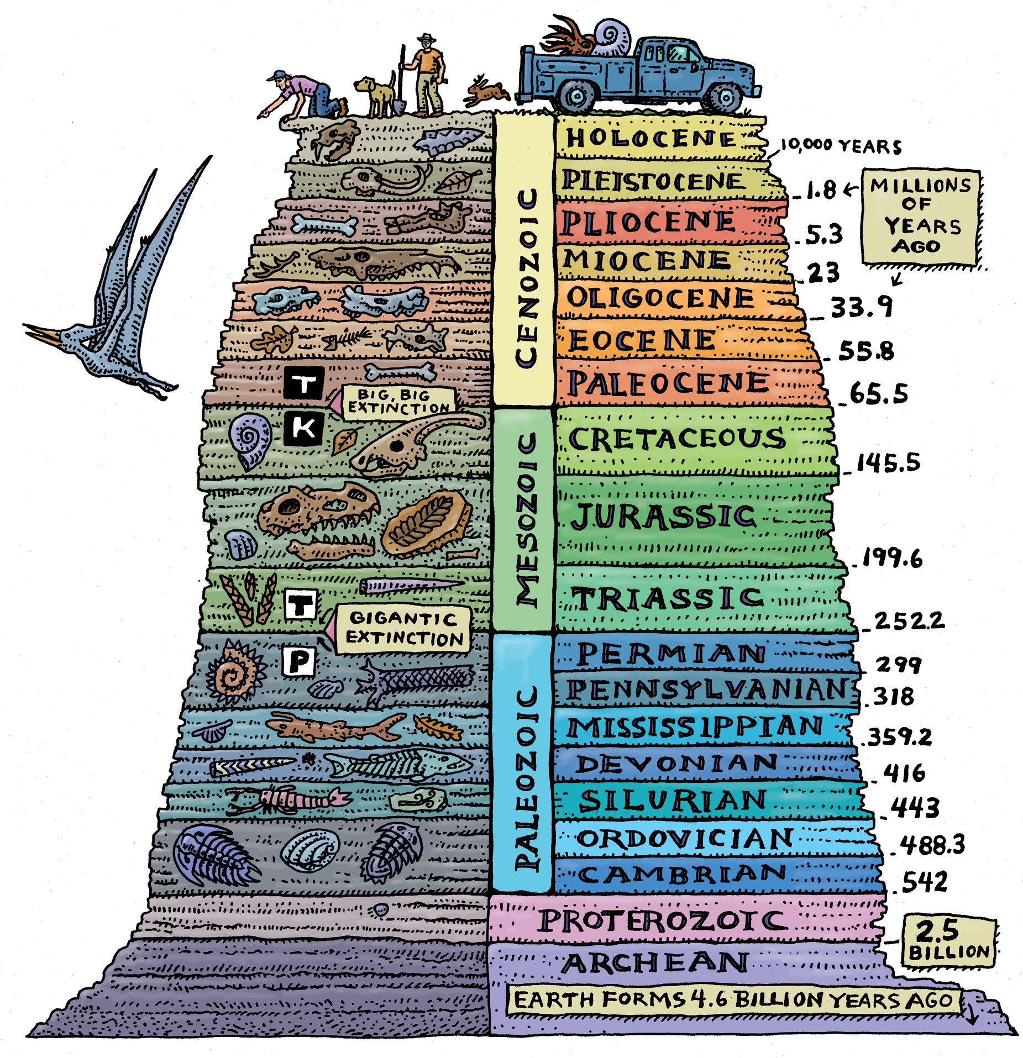
Earth’s geology is dynamic, and a human lifetime is a blink of an eye in the long course of geologic time.

Slide 4
Earth consists of layers

Slide 5
Anatomy of Earth
Earth’s surface is covered by a layer of rock called crust.
The crust is part of the top layer of Earth called the lithosphere
The lithosphere is not continuous. It is actually made up of large pieces or slabs called tectonic plates

Slide 6
The top of a tectonic plate is made of crust. There are two types of crust:
Oceanic crust is dense and thin. It is made of igneous rocks and minerals. We most often associate basalt with ocean crust.
Continental crust is less dense and thick. It is made of all types of rocks and minerals. We most often associate granite with continental crust.
It is important to know what type of crust covers a tectonic plate because the type of crust determines what happens at a boundary between plates

Slide 7
Tectonic plates move/slide over Earth’s asthenosphere-top of the mantle
The asthenosphere is unevenly heated by Earth’s core. This uneven heating causes the tectonic plates to move.

Slide 8
Tectonics produces Earth’s landforms

Slide 9
Plate Boundaries

Slide 10
What happens at plate boundaries?
When plates move away from each other, this causes tension.
New crust/lithosphere is created.
When plates move towards each other, this causes compression.
Crust/lithosphere is destroyed
When plates slide past each other, it creates a shearing force.
They “grind” past each other, which creates disturbances such as earthquakes.

Slide 11
Convergent Boundary
2 tectonic plates move towards each other at a convergent boundary
also called a destructive plate boundary because one plate is slowly destroyed at the boundary

Slide 12
Left Hand Side: Plate Boundaries, Convergent Boundary
At a convergent boundary, the more dense plate subducts or moves below the other plate. The subducted plate melts and becomes part of the mantle

Slide 13
Divergent Boundary
2 tectonic plates move away from each other at a divergent boundary
Also called a constructive boundary because new crust or lithosphere is created at the boundary

Slide 14
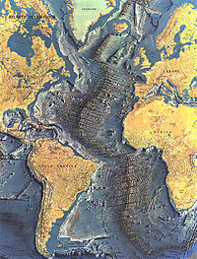
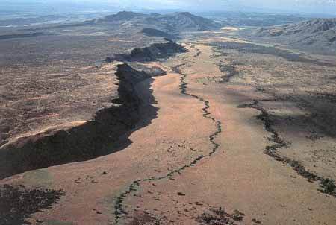
Left Hand Side: Plate Boundaries, Divergent Boundary
Oceanic Plate Divergence: molten rock moves upward and fills the space between plates. The molten rock cools and forms ocean ridges.
such as the Mid-Atlantic Ridge and the East Pacific Ridge
Continental Plate Divergence: the land sinks and a rift valley is created.
The East African Rift Valley and Iceland are landforms created by this type of movement.

Slide 15
Transform Boundary
2 tectonic plates slide past each other at a transform boundary
Also called a conservative plate boundary because crust is neither created nor destroyed at this boundary

Slide 16
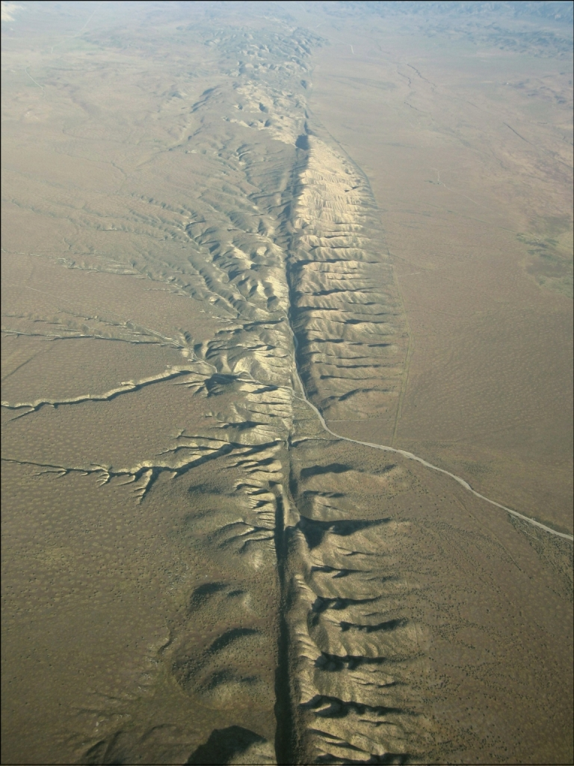
Left Hand Side: Plate Boundaries, Transform Boundary
Transform boundaries are often found between two convergent, two divergent, or a convergent and a divergent boundary
The San Andreas Fault is one of the most well-known transform boundary

Slide 17
Left Hand Side: Types of Convergent Boundaries
Oceanic-Oceanic Convergence: One plate subducts under the other, forming a trench. Often, underwater volcanoes form near the boundary of the other plate.
Example: Japan, the Aleutian Islands (Alaska), Philippines, Easter Caribbean Islands (Martinique, St. Lucia, and the Grenadines)

Slide 18
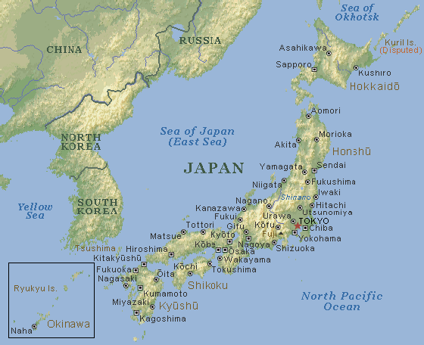
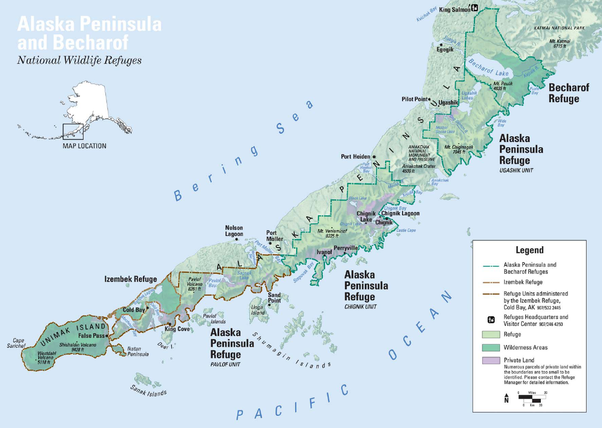
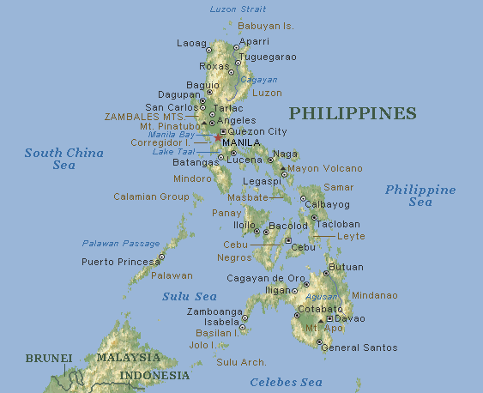
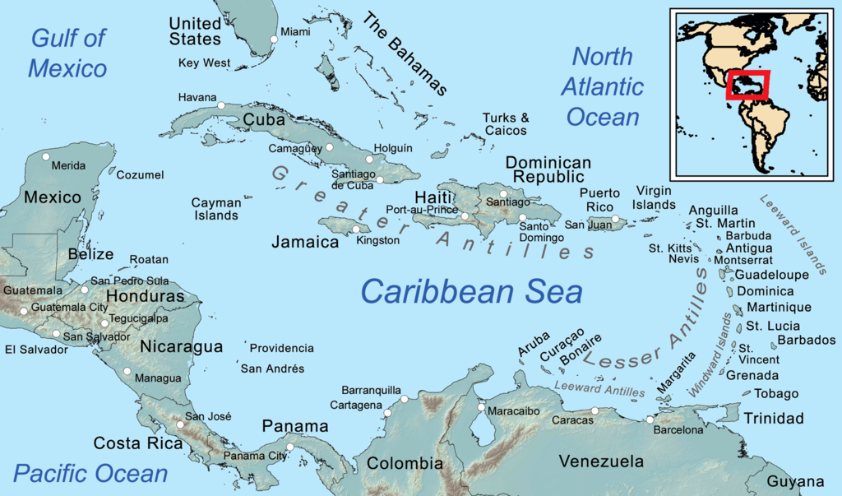

Slide 19
Oceanic-Continental Convergence: The oceanic plate subducts under the continental plate because it is more dense. A trench forms at the boundary.
Often, mountains or volcanoes form on the continental plate near the boundary.
Ex. Andes mountains

Slide 20
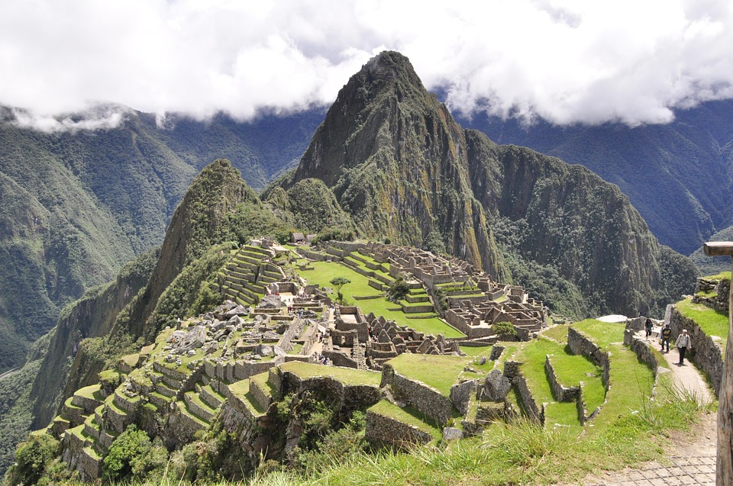
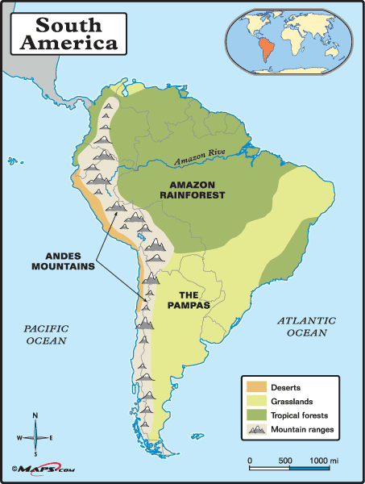

Slide 21
Continental-continental convergence: One plate subducts, melts and becomes part of the mantle. A mountain range forms in the other plate where crust is “squashed” together.
Example: The Himalayan mountains

Slide 22
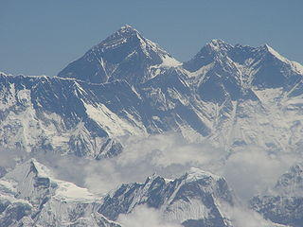
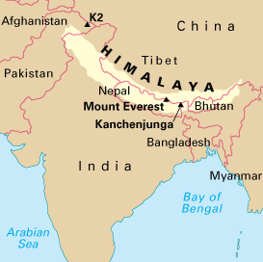

Slide 23
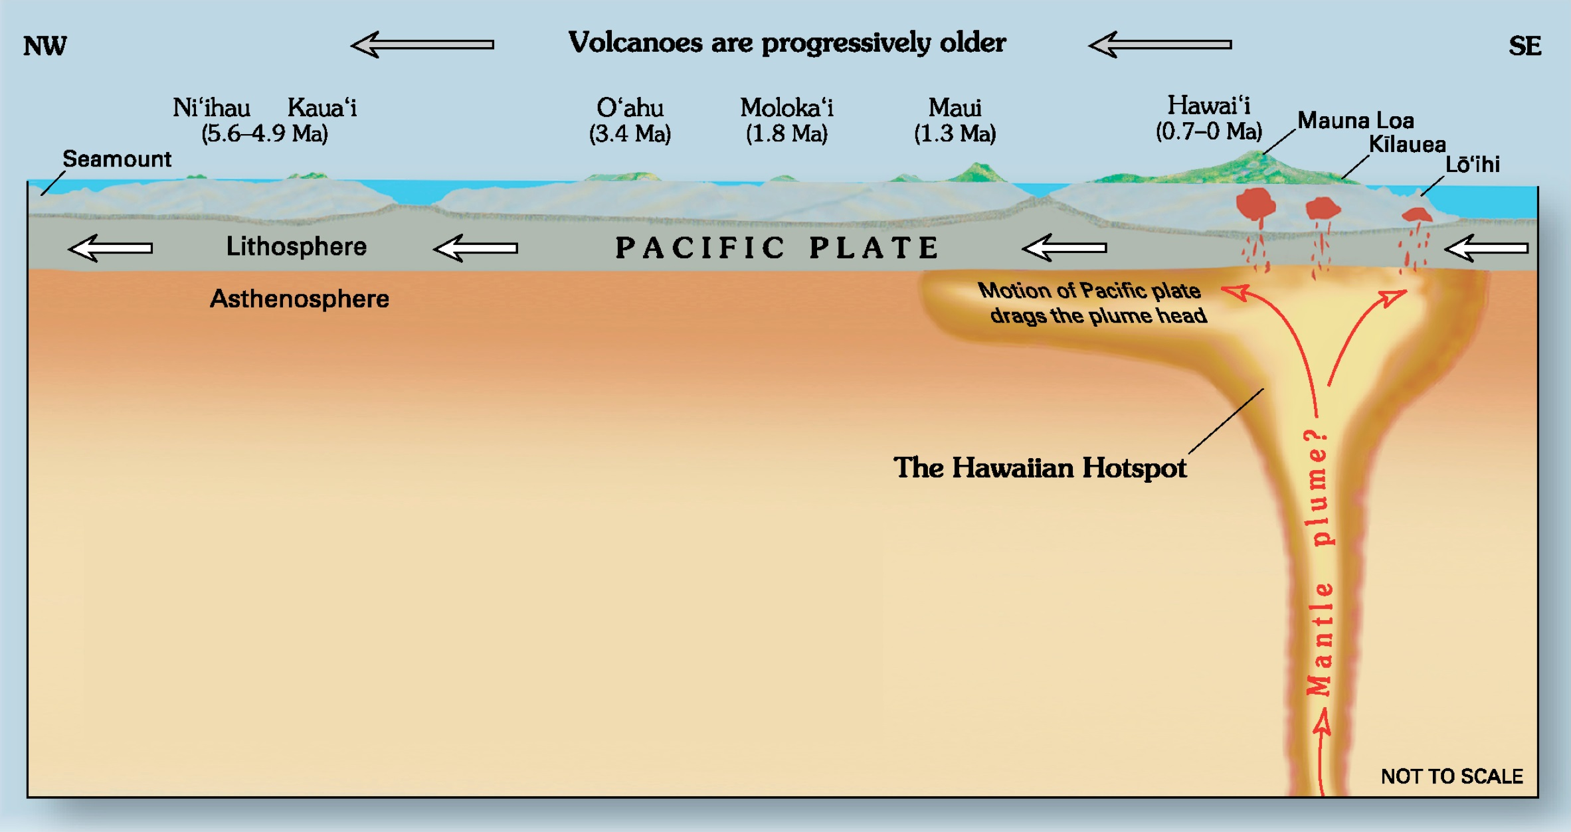
Volcanoes arise from rifts, subduction zones, or hotspots
The Hawaiian Islands are an example of landforms made from a hotspot

Slide 24
Earthquakes result from movement at plate boundaries and faults
The circum-Pacific belt, or “ring of fire”, spawns most of the world’s volcanoes and earthquakes
We cannot prevent them, but we can build structures and cities in safer ways.

Slide 26
Plate tectonics shape Earth’s geography
Plate tectonics is a fundamental system that shapes Earth’s physical geography, as well as producing earthquakes and volcanoes.

Slide 27
Continental Drift Theory

Slide 28
A theory that explains the movement of tectonic plates and thus continents.
According to theory, the continents used to be joined together. Overtime, they moved and split up.

Slide 30
Evidence for Continental Drift Theory
Landform Evidence- continents fit together like puzzle pieces
Geology Evidence- coal deposits in North America and Europe are similar
Fossil Evidence- plant and animal fossils found on different continents are the same

Slide 31
Seasons and Solar Intensity

Slide 32
Seasons

Slide 33
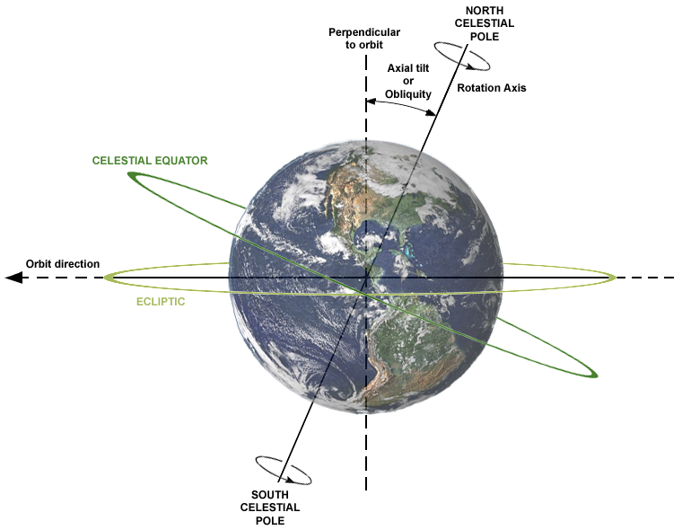
The Earth spins on an Axis
The axial tilt of Earth is the cause of seasons like summer and winter on Earth.

Slide 34
The hemispheres receive more or less hours of sunlight depending on the season
SPRING & FALL
The latitudinal lines line up with the sun’s direct rays
The sun shines directly onto the equator
All hemispheres receive 12 hours of daylight

Slide 35
SUMMER in the Northern Hemisphere, WINTER in the Southern Hemisphere
The sun shines directly onto the Tropic of Cancer
The North experiences 15 hours of daylight, the South receives 9

Slide 36
WINTER in the Northern Hemisphere, SUMMER in the Southern Hemisphere
The sun shines directly onto the Tropic of Capricorn
The North experiences 9 hours of daylight, the South receives 15

Slide 37
Solar Radiation

Slide 38
Insolation is the amount/intensity of solar radiation that reaches the earth's surface.
It is measured by the amount of solar energy received per square centimeter per minute.
Insolation is measured in degrees: the higher the angle the higher the temperature

Slide 39
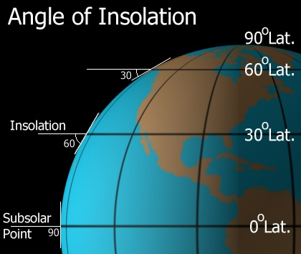

Slide 40
Insolation affects temperature; the more the insolation, the higher the temperature.
At 90° the sun is at it's most intense. This can be found in areas near the equator.
Nearer to 0° the sun is at it's least intense like at the north pole where it is very cold.
On the earth the insolation changes just due to location in our orbit, but for the most part, the extreme ends have low angles and the middle of the earth has higher angles.

